Slide 1
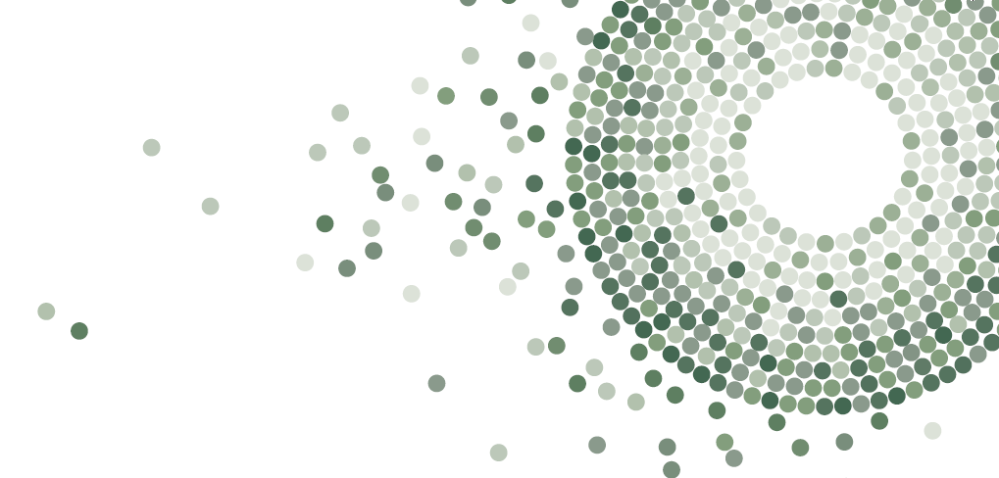
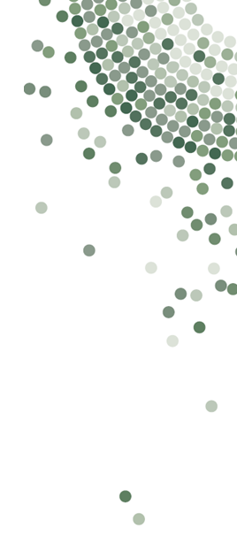
Our Diversity: What You Told Us
x% of us are Aboriginal and/or Torres Strait Islander Compared to 2.1% of the Australian workforce
x is our median age
x% of us have caring responsibilities Compared to 42% of the Australian workforce
x% of us are a person with disability Compared to 9% of the Australian workforce
x% of us identify as LGBTIQ+ Compared to 11% of the Australian workforce
x% of us were born overseas Compared to 33% of the Australian workforce
x cultural backgrounds are represented by us
x% of us are multilingual across x languages

Slide 2
Our Diversity: What You Told Us
10% of us are Aboriginal and/or Torres Strait Islander Compared to 2.1% of the Australian workforce
39 is our median age
38% of us have caring responsibilities Compared to 42% of the Australian workforce
EXAMPLE
22% of us are a person with disability Compared to 9% of the Australian workforce
30% of us identify as LGBTIQ+ Compared to 11% of the Australian workforce
42% of us were born overseas Compared to 33% of the Australian workforce
45 cultural backgrounds are represented by us
62% of us are multilingual across 32 languages
Notes:
EXAMPLE

Slide 3
Our Diversity: What You Told Us
10% of us are Aboriginal and/or Torres Strait Islander Compared to 2.1% of the Australian workforce
39 is our median age
38% of us have caring responsibilities Compared to 38% of the Australian workforce
22% of us are a person with disability Compared to 9% of the Australian workforce
30% of us identify as LGBTIQ+ Compared to 11% of the Australian workforce
42% of us were born overseas Compared to 33% of the Australian workforce
45 cultural backgrounds are represented by us
62% of us are multilingual across 32 languages
Notes:
EXAMPLE

